Slide 1

Applications of Neural Networks with Long Short-Term Memory (LSTM)
Guidance- by- Prof. Dr. Jörg Schäfer 1. shaikh safir Mohammad (1322554) Ms. Fatima butt 2. Yelpale Kshitij (1322509)

Slide 2
Introduction
Problems with traditional neural network:
Inputs and outputs are of different lengths in different examples, e.g. Machine Translation
They do not share features learned across different positions of text.
What is Recurrent Neural Network ?
Neurons in layer i get feed forward input and receive input from neurons in higher (following) layers, usually next layer i+1 (backward), but also from neurons of same layer i.
Widely used in natural language processing.
Applications of NN with LSTM

Slide 3
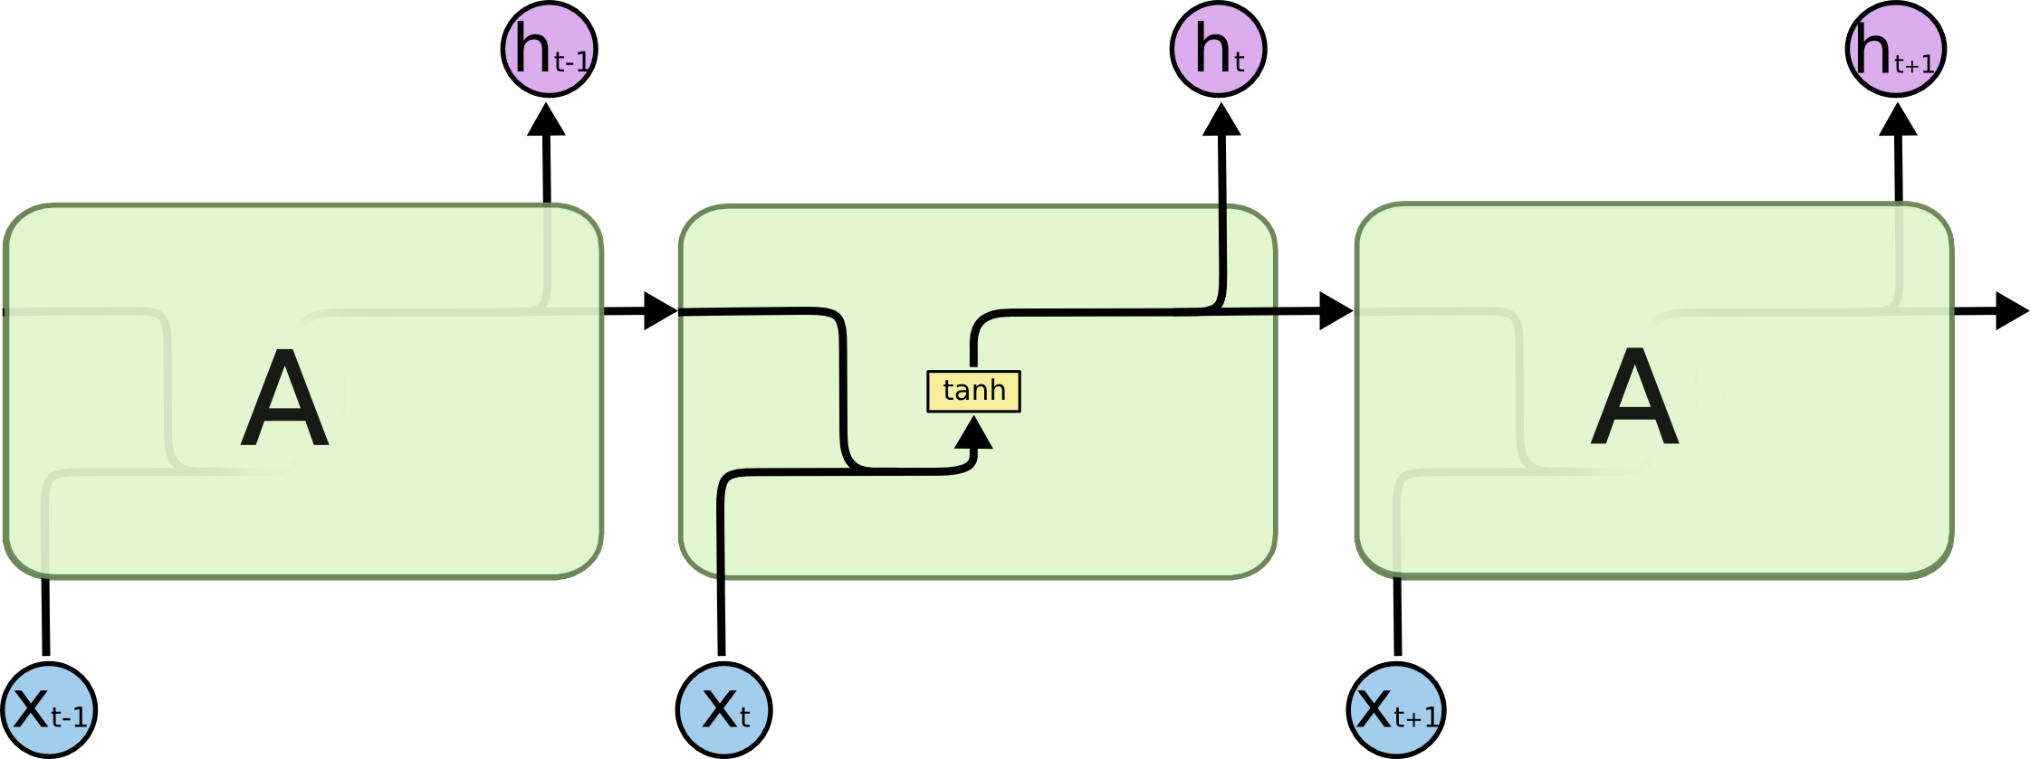
Structure of RNN
Fig: RNN Architecture [1]
Applications of NN with LSTM
3
Notes:
Colah, 2015. Understanding LSTM Networks. [Blog] Colah's Blog, Available at: <http://colah.github.io/posts/2015-08-Understanding-LSTMs/> [Accessed 11 September 2020].

Slide 4

Activation function – Hyperbolic Tangent
Fig: Tanh Activation Function [2]
Applications of NN with LSTM
4
Notes:
Phi, M., Medium. 2018. Illustrated Guide to LSTM’s and GRU’s: A step by step explanation. [Blog] Available at: <https://towardsdatascience.com/illustrated-guide-to-lstms-and-gru-s-a-step-by-step-explanation-44e9eb85bf21> [Accessed 11 September 2020].

Slide 5
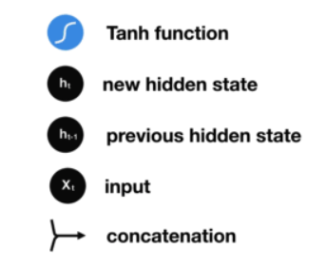

Structure of RNN Cell
[3]
Fig: RNN Cell [2]
Applications of NN with LSTM
5
Notes:
Phi, M., Medium. 2018. Illustrated Guide to LSTM’s and GRU’s: A step by step explanation. [Blog] Available at: <https://towardsdatascience.com/illustrated-guide-to-lstms-and-gru-s-a-step-by-step-explanation-44e9eb85bf21> [Accessed 11 September 2020].

Slide 6
Gradient Problem in RNNs
What is Gradient?
BPTT
2 major gradient problems in standard RNN structure:
Vanishing gradient
Exploding gradient
Learning algorithm can not reach at global minima in both problems
Applications of NN with LSTM
6

Slide 7
Vanishing Gradient
Fig: Vanishing Gradient [2]
Gradient get minimal during back-propagation causing no effect on the learning of initial layers.
New weight = old weight – learning rate * gradient
10.999 = 10.1 – 0.001
High chances In case of Sigmoid activation function. So Tanh is preferred one!
Applications of NN with LSTM
7
Notes:
Phi, M., Medium. 2018. Illustrated Guide to LSTM’s and GRU’s: A step by step explanation. [Blog] Available at: <https://towardsdatascience.com/illustrated-guide-to-lstms-and-gru-s-a-step-by-step-explanation-44e9eb85bf21> [Accessed 11 September 2020].

Slide 8
Exploding Gradient
Exploding gradient tends to be the bigger problem with training RNNs, although when exploding gradients happens, it can be catastrophic because the exponentially large gradients can cause our parameters to become so large that your neural network parameters get really messed up
In case of ReLU function, gradient can be > 1 and on every successive layer it increases exponentially
But exploding gradients are easier to spot because the parameters just blow up and you might often see NaNs, or not a numbers, meaning results of a numerical overflow in your neural network computation.
Applications of NN with LSTM
8

Slide 9
Solutions to Gradient Problem
Exploding gradient
Truncated Backpropagation
Penalties
Gradient Clipping
Vanishing gradient
Weight Initialization
Echo State Networks
Long Short-Term Memory Networks (LSTM)
Applications of NN with LSTM
9

Slide 10
LSTMs mimic Human Memory
Fig: LSTMs mimic Human Memory [2]
Applications of NN with LSTM
10
Notes:
Phi, M., Medium. 2018. Illustrated Guide to LSTM’s and GRU’s: A step by step explanation. [Blog] Available at: <https://towardsdatascience.com/illustrated-guide-to-lstms-and-gru-s-a-step-by-step-explanation-44e9eb85bf21> [Accessed 11 September 2020].

Slide 11

LSTM Architecture
Fig: LSTM Architecture [1]
Applications of NN with LSTM
11
Notes:
Colah, 2015. Understanding LSTM Networks. [Blog] Colah's Blog, Available at: <http://colah.github.io/posts/2015-08-Understanding-LSTMs/> [Accessed 11 September 2020].

Slide 12
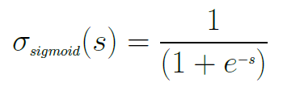
Activation function – Sigmoid
Fig: Sigmoid Activation Function [2]
Applications of NN with LSTM
12
Notes:
Phi, M., Medium. 2018. Illustrated Guide to LSTM’s and GRU’s: A step by step explanation. [Blog] Available at: <https://towardsdatascience.com/illustrated-guide-to-lstms-and-gru-s-a-step-by-step-explanation-44e9eb85bf21> [Accessed 11 September 2020].

Slide 13

Forget Gate
Fig: Forget Gate [2]
Applications of NN with LSTM
13
Notes:
Phi, M., Medium. 2018. Illustrated Guide to LSTM’s and GRU’s: A step by step explanation. [Blog] Available at: <https://towardsdatascience.com/illustrated-guide-to-lstms-and-gru-s-a-step-by-step-explanation-44e9eb85bf21> [Accessed 11 September 2020].

Slide 14

Input Gate
Fig: Input Gate [2]
Applications of NN with LSTM
14
Notes:
Phi, M., Medium. 2018. Illustrated Guide to LSTM’s and GRU’s: A step by step explanation. [Blog] Available at: <https://towardsdatascience.com/illustrated-guide-to-lstms-and-gru-s-a-step-by-step-explanation-44e9eb85bf21> [Accessed 11 September 2020].

Slide 15

Cell State
Fig: Cell State [2]
Applications of NN with LSTM
15
Notes:
Phi, M., Medium. 2018. Illustrated Guide to LSTM’s and GRU’s: A step by step explanation. [Blog] Available at: <https://towardsdatascience.com/illustrated-guide-to-lstms-and-gru-s-a-step-by-step-explanation-44e9eb85bf21> [Accessed 11 September 2020].

Slide 16

Output Gate
Fig: Output Gate [2]
Applications of NN with LSTM
16
Notes:
Phi, M., Medium. 2018. Illustrated Guide to LSTM’s and GRU’s: A step by step explanation. [Blog] Available at: <https://towardsdatascience.com/illustrated-guide-to-lstms-and-gru-s-a-step-by-step-explanation-44e9eb85bf21> [Accessed 11 September 2020].

Slide 17







Backpropagation in LSTMs
Similar to RNN and ANN back-propagation algorithms.
2 Passes:
Forward Pass
Step 1 to T
Backward Pass
Step T to 1
[3]
Applications of NN with LSTM
17

Slide 18
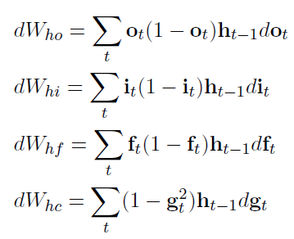
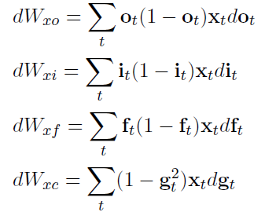
Backpropagation in LSTMs
Back-propagate the activation functions over the whole sequence
The weights W_{xo}, W_{xi}, W_{xf} and W_{xc} are shared across the whole sequence, thus we need to take the same summation over t
[3]

Slide 19
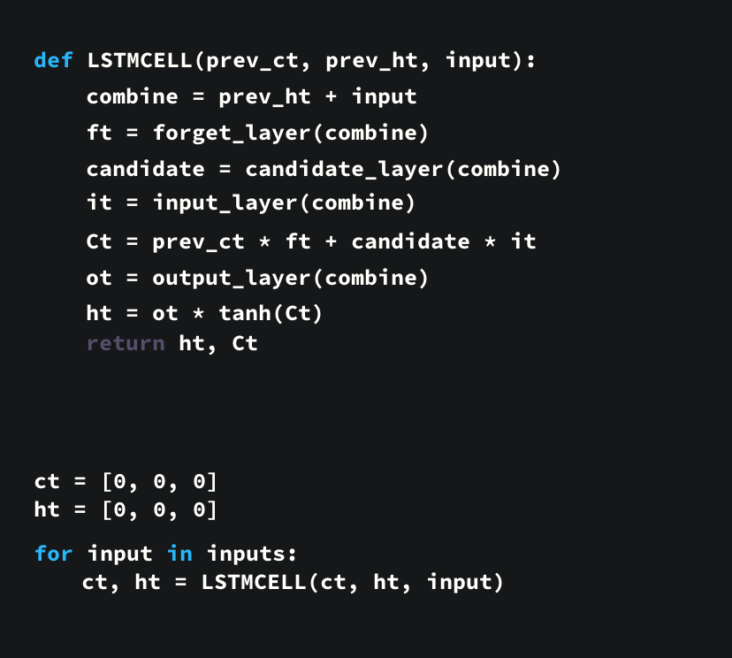
Pseudo Code
Applications of NN with LSTM

Slide 20
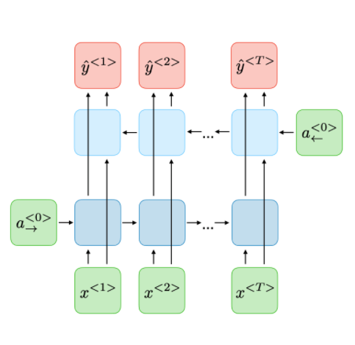
Other variants – Bi directional RNN/LSTM
Fig: Bi – Directional Variant [4]
Applications of NN with LSTM
20

Slide 21
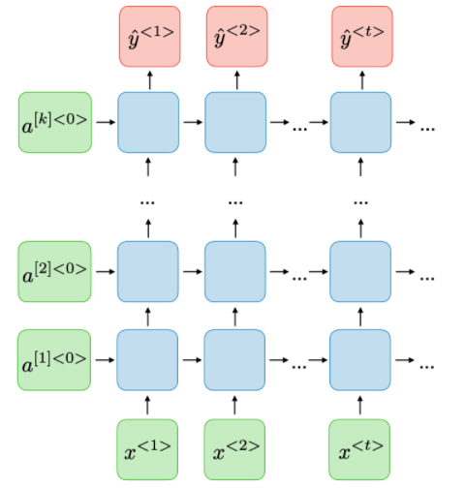
Other variants – Deep RNN/LSTM
Fig: Deep RNN/LSTM [4]
Applications of NN with LSTM
21

Slide 22
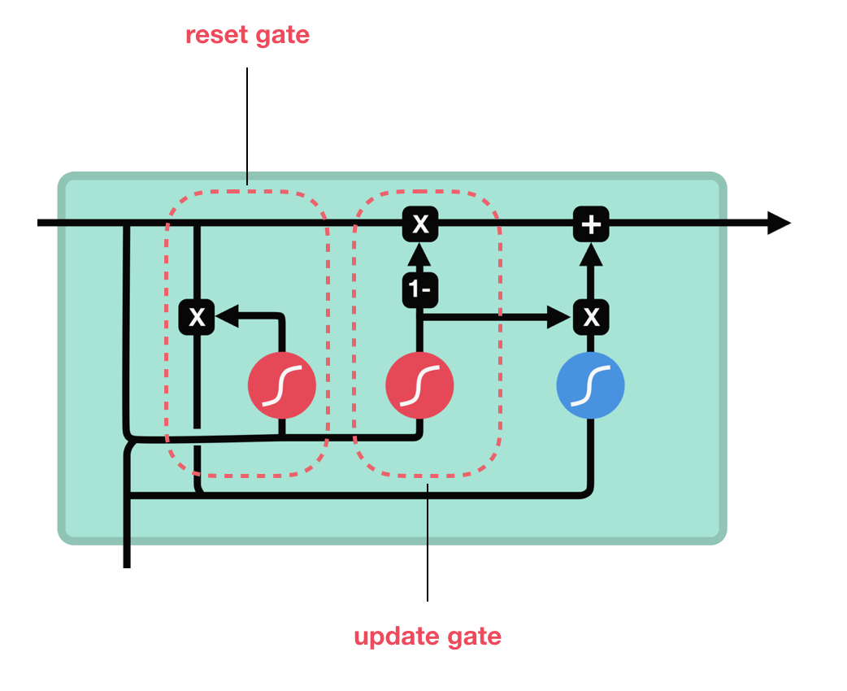
Other variants – Gated Recurrent Unit (GRU)
Fig: GRU Cell [2]
Applications of NN with LSTM
22

Slide 23
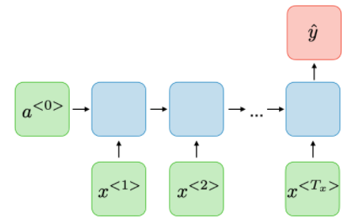
Application – Sentiment Analysis
LSTM is better in analyzing emotion of long sentences and can produce better accuracy and recall rate [5]
Sentiment Analysis is -
the term which is used very often in web-based business sites, social networks and different fields.
an examination field to analyze people’s subjective sentiments.
More Advanced, Focus on “Beyond Polarity”
[4]
Applications of NN with LSTM
23

Slide 24
Implementation
Dataset: IMDB Movie Reviews [6]
Data Pre-processing
Library: Keras
Word Embedding: One-Hot representation + Keras encoded Imdb format
Model: (Embedding + Bidirectional(LSTM( )) + Bidirectional(LSTM( )) + Dense)
Applications of NN with LSTM
24

Slide 25
Performance Measures
 | # Epochs | Training Accuracy | Validation Accuracy
LSTM (Trained on Custom IMDB Dataset with One-Hot Encoding) | 15 | 99.85 % | 82.96 %
LSTM (Trained on Keras’ IMDB Dataset) | 3 | 85.42 % | 82.81 %
Bi-LSTM (Trained on Keras’ IMDB Dataset) | 2 | 89.98 % | 86.89 %
Applications of NN with LSTM
25

Slide 26
Demo
Applications of NN with LSTM
26

Slide 27
Challenges
Context
Irony
Sarcasm
Emojis (:D, ¯ \ _ (ツ) _ / ¯ etc.)
Definition of Neutral
Overfitting
Large difference between training and validation accuracy
Keras’ feature updates!
Applications of NN with LSTM
27

Slide 28
Results - Correlation
Performed correlation test –
between predicted values of LSTM and actual sentiments
on 4500 documents (sentiments)
Correlation Coefficient Test | LSTM and Actual sentiment
Pearson | 0.882
Spearman Rank | 0.886
Applications of NN with LSTM
28

Slide 29
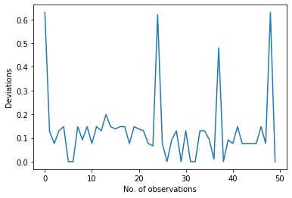
Results – Characteristic Values
Deviations | LSTM and User sentiment
Mean | 0.133
Standard Deviation | 0.147
Applications of NN with LSTM
29

Slide 30
Other Applications
Speech recognition
Speech synthesis
Text generation
Video captioning
Time series analysis
Name entity recognition
Video activity recognition
Image captioning
Machine translation
Music generation
Applications of NN with LSTM
30

Slide 31
References
[1] Colah, 2015. Understanding LSTM Networks. [Blog] Colah's Blog, Available at: <http://colah.github.io/posts/2015-08-Understanding-LSTMs/> [Accessed 11 September 2020].
[2] Phi, M., Medium. 2018. Illustrated Guide to LSTM’s and GRU’s: A step by step explanation. [Blog] Available at: <https://towardsdatascience.com/illustrated-guide-to-lstms-and-gru-s-a-step-by-step-explanation-44e9eb85bf21> [Accessed 11 September 2020].
[3] [cs.LG] Chen *, G., 2018. A Gentle Tutorial Of Recurrent Neural Network With Error Backpropagation. Department of Computer Science and Engineering, SUNY at Buffalo.
[4] Amidi, A. and Amidi, S., n.d. CS 230 - Recurrent Neural Networks Cheatsheet. [online] Stanford.edu. Available at: <https://stanford.edu/~shervine/teaching/cs-230/cheatsheet-recurrent-neural-networks> [Accessed 14 September 2020].
[5] Hochreiter, Sepp & Schmidhuber, Jürgen. (1997). Long Short-term Memory. Neural computation. 9. 1735-80. 10.1162/neco.1997.9.8.1735.
[6] Andrew L. Maas, Raymond E. Daly, Peter T. Pham, Dan Huang, Andrew Y. Ng, and Christopher Potts. (2011). Learning Word Vectors for Sentiment Analysis. The 49th Annual Meeting of the Association for Computational Linguistics (ACL 2011).
Applications of NN with LSTM
31

Slide 32
Thank you!
Applications of NN with LSTM
32

